Slide 1


Algorithm for Avoiding Street Harassment by Using Secure Routes

Slide 2


Presentation of the team
Mariana García
Investigator
Maria Camila Raigosa
Investigator
Isabella Márquez
Writer
https://github.com/httpsmariana/proyecto-1

Slide 3


Presentation of the team
Andrea Serna
Literature review
Mauricio Toro
Data preparation
https://github.com/httpsmariana/proyecto-1

Slide 4

Problem Statement
Shortest path algorithm
Streets
of Medellín, Origin and Destination
Three paths that reduce both the risk of harassment and distance

Slide 5
Solution Algorithm
Dijkstra
Algorithm
Streets
of Medellín, Origin and Destination
A path that reduces both distance and harassment

Slide 6
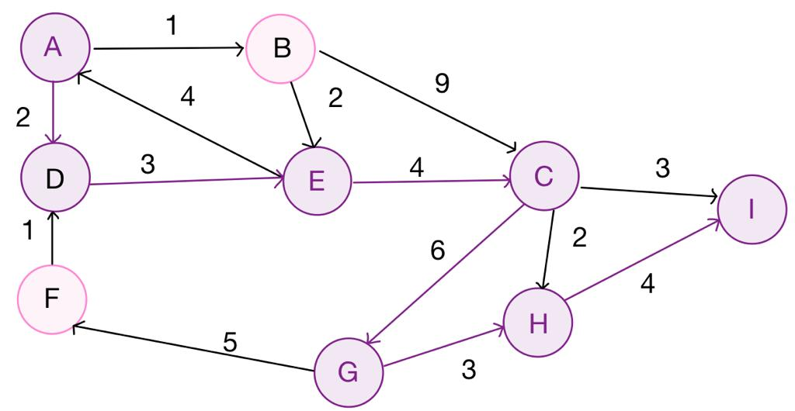
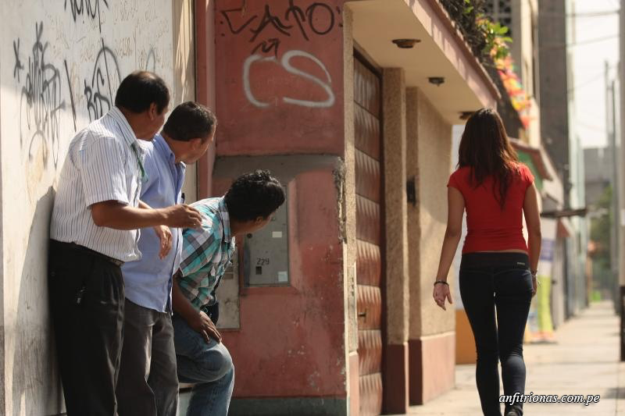
Explanation of the algorithm
Dijkstra Algorithm
in the graph we can see how the algorithm demarcates the fastest and safest route by evaluating the possible cases and states of the routes.

Slide 7

Keep this title
Complete this slide
For the third installment
Complexity of the algorithm
 | Time complexity | Complexity of memory
Algorithm name | O(V² *E*2^{V} ) | O(E!*V*E*E*2E )
Algorithm name (if you have tried two) | O(V*V*E*E*E) | O(E!)
Create the table in Powerpoint. Do not copy pixelated screenshots of the white paper, please.
Do NOT use red on the slides.
Time and memory complexity of the algorithm name. V is...E is... (In this semester, it could be DFS, BFS, Dijkstra, A*). Please explain what V and E mean in this problem. PLEASE, it is not helpful to put 'n'.
Include a high-definition image related to the problem of sexual street harassment.
Explain the tables in your
own words
Use superscripts to represent exponents. Do NOT use the ^ symbol.
The font size must be at least 22 points.

Slide 8
Keep this title
Complete this slide
For the third installment
First path minimizing d = ???
Create the table in Powerpoint. Do not copy pixelated screenshots from the white paper, please.
Do NOT use red on the slides.
Origin | Destination | Distance (meters) | Risk of harassment (between 0 and 1)
EAFIT University | National University | ?? | ??
Distance and risk of harassment for the path that minimizes d = ??. Execution time of ?? seconds.
Explain the tables in your
own words
The font size must be at least 22 points.

Slide 9
Keep this title
Complete this slide
For the third installment
Second path minimizing d = ???
Create the table in Powerpoint. Do not copy pixelated screenshots of the white paper, please.
Do NOT use red on the slides.
Origin | Destination | Distance (meters) | Risk of harassment (between 0 and 1)
EAFIT University | National University | ?? | ??
Distance and risk of harassment for the path that minimizes d = ??. Execution time of ?? seconds.
Explain the tables in your
own words
The font size must be at least 22 points.

Slide 10
Keep this title
Complete this slide
For the third installment
Third path minimizing d = ???
Create the table in Powerpoint. Do not copy pixelated screenshots of the white paper, please.
Do NOT use red on the slides.
Origin | Destination | Distance (meters) | Risk of harassment (between 0 and 1)
EAFIT University | National University | ?? | ??
Distance and risk of harassment for the path that minimizes d = ??. Execution time of ?? seconds.
Explain the tables in your
own words
The font size must be at least 22 points.

Slide 11

Keep this title
Complete this slide
For the third installment
Visual comparison of the three paths
Use a library to draw the map and plot the three roads between Eafit and Universidad Nacional. For example, use geopandas, pydeck or google maps.
Do NOT use red on the slides.
The font size must be at least 22 points.

Slide 12

Complete this slide
For the third installment
Future work directions
Keep this title
Do NOT use red on the slides.
Please name the courses in which you could continue to work on this project.
Probability
Optimization 1
Statistics 2
M & S 4
Other risk estimates
Optimization Bi target
MV risk estimates
Traffic Estimation
Delete this
if you study
Informatics engineering
Please tell us what you could do, in the following courses, to improve this project.
The font size must be at least 22 points.
You can add, delete or change some future work addresses

Slide 13
Complete this slide
For the third installment
Future work directions
Keep this title
Do NOT use red on the slides.
Please name the courses in which you could continue to work on this project.
Databases
Project 1
Software Engineering
Project 2
Other variables
Web application
Mobile application
Include ML or VR
Delete this
if you study
Mathematics
Engineering
Please tell us what you could do, in the following courses, to improve this project.
The font size must be at least 22 points.
You can add, delete or change some future work addresses

Slide 14

Complete this slide
For the third installment
Report accepted in OSF.IO
Keep this title
Do NOT use red on the slides.
Delete this slide if your report was not submitted to OSF.
This is an example screenshot from a previous report
This is an example of a citation from a previous report
Include the report citation in OSF PREPRINTS and the link. No, not in OSF projects, it is in OSF Preprints.
Julián Ramírez, Andrés Salazar, Simón Marín, Mauricio Toro. Energy and Storage Optimization in Precision Livestock Farming. Technical Report, Universidad EAFIT, 2021. https://doi.org/10.31219/osf.io/du8yt
Include a screenshot of your published report on osf.io and remove the circle
The font size must be at least 22 points.
Include monitors and teachers among the authors, please.

Slide 15

THANK YOU!!!
You can change this picture
Complete this slide
For the third installment
Do NOT use red on the slides.
Don't forget your scholarship acknowledgements (if you have one) For others, for those who pay your tuition fees
With the support of
The first two authors were supported by the Sapiencia grant, financed by the municipality of Medellín. All authors are grateful to the Vice Rector's Office for Discovery and Creation, Universidad EAFIT, for their support in this research.
The font size must be at least 22 points.

